Slide 1
Database Management Systems
Generated for: Introduction to Database Normalization, Types of Normal Forms, Advantages of Normalization
Notes:
Welcome to the Database Management Systems presentation covering multiple topics. Today we'll explore: Introduction to Database Normalization, Types of Normal Forms, Advantages of Normalization.

Slide 2
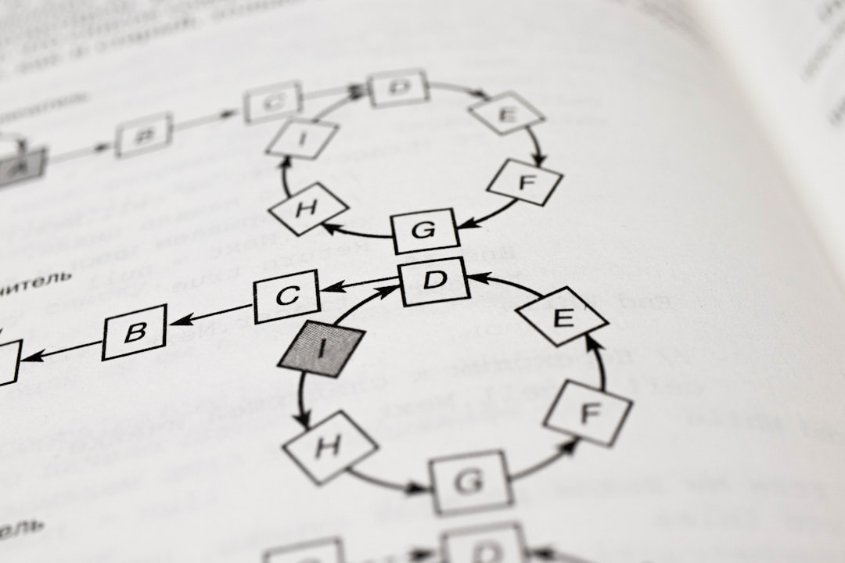
Introduction to Database Normalization - Introduction
Database normalization reduces data redundancy and dependency
Improves data integrity and scalability in database systems
Helps eliminate data anomalies and inconsistencies
Ensures data is stored in one place and one place only
Supports better data security and access control
Applies to relational databases and other data models
Normal forms include 1NF, 2NF, and 3NF standards
Denormalization is used for performance optimization
Normalization is a crucial step in database design
Enhances data management and query performance
Notes:
When introducing database normalization, explain its importance in reducing data redundancy and improving data integrity. Provide examples of data anomalies and inconsistencies that can occur without normalization. Discuss the different normal forms, such as 1NF, 2NF, and 3NF, and how they are applied in database design. Ask students to consider the trade-offs between normalization and denormalization for performance optimization. Key takeaways should include the benefits of normalization, its role in database design, and its impact on data management and query performance.

Slide 3

Introduction to Database Normalization - Fundamentals
Database normalization reduces data redundancy
Eliminates data inconsistencies and anomalies
Improves data integrity and scalability
Supports better data security and access
Normal forms include 1NF, 2NF, and 3NF
Higher normal forms include BCNF and 4NF
Denormalization for performance optimization
Normalization techniques for relational databases
Data modeling and database design principles
Notes:
When introducing database normalization, emphasize its importance in reducing data redundancy and improving data integrity. Explain each normal form, starting with 1NF, and provide examples of how they eliminate data inconsistencies. Discuss the trade-offs between normalization and denormalization for performance optimization. Ask students to consider scenarios where normalization is crucial, such as in e-commerce databases, and how it supports better data security and access. Key takeaways include understanding the normal forms, normalization techniques, and their applications in database design.

Slide 4
Introduction to Database Normalization - Fundamentals
Database normalization reduces data redundancy
Eliminates data inconsistencies and anomalies
Improves data integrity and scalability
Supports better data organization and structure
Normal forms include 1NF, 2NF, and 3NF
Higher normal forms include BCNF and 4NF
Denormalization is used for performance optimization
Normalization rules are based on dependencies
Functional dependencies define relationships
Normalizing databases improves query performance
Notes:
When introducing database normalization, explain that it's a process of organizing data to minimize redundancy and dependency. Provide examples of how normalization can improve data integrity and scalability. Discuss the different normal forms, such as 1NF, 2NF, and 3NF, and explain how they eliminate data inconsistencies and anomalies. Use a simple example, like a customer database, to illustrate the benefits of normalization. Ask students to consider how denormalization can be used for performance optimization and how it can impact data consistency. Key takeaways should include the importance of normalization in database design and its impact on data quality and query performance.

